Slide 1
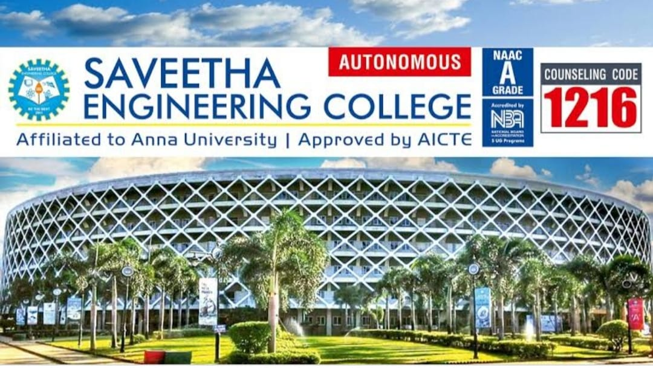
Done by:
B.PREETHI
S.NIRANJANA DEVI
DEPARTMENT:B.TECH INFORMATION TECHNOLOGY

Slide 2
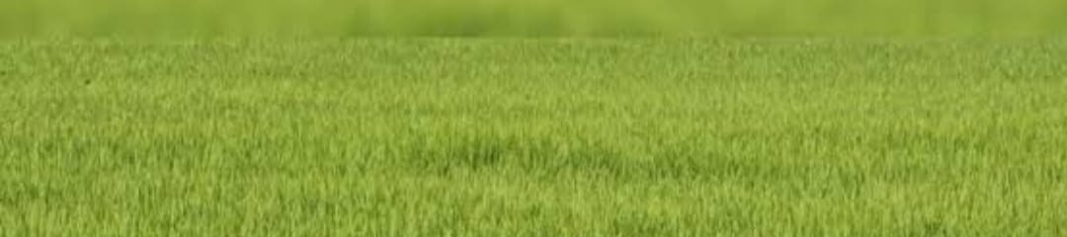
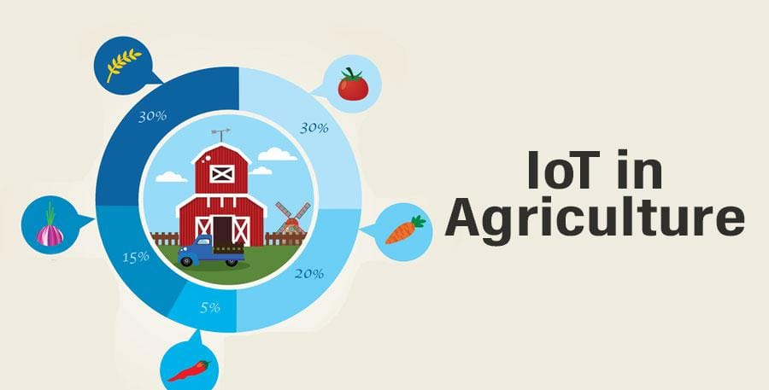
INTERNET OF THINGS IN AGRICULTURE

Slide 3
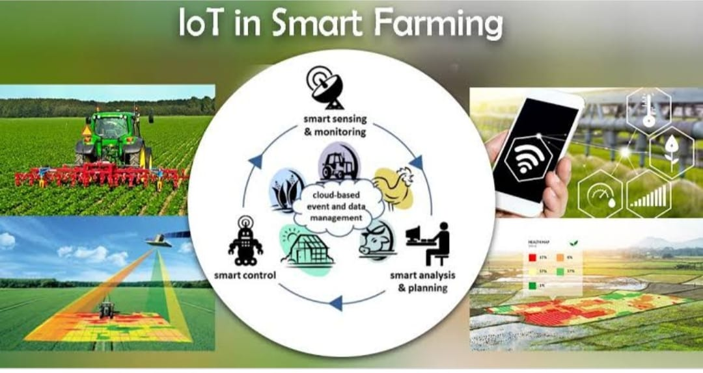
AGENDA:
INTRODUCTION OF IOT
EVOLUTION IN IOT
IOT IN AGRICULTURE
DRONES
LIVESTOCK MONITORING
SMART GREENHOUSE
SOIL MONITORING
ESTIMATE OF IOT DEVICE IN AGRICULTURE.
BENEFITS AND RISKS.
CONCLUSION.

Slide 4
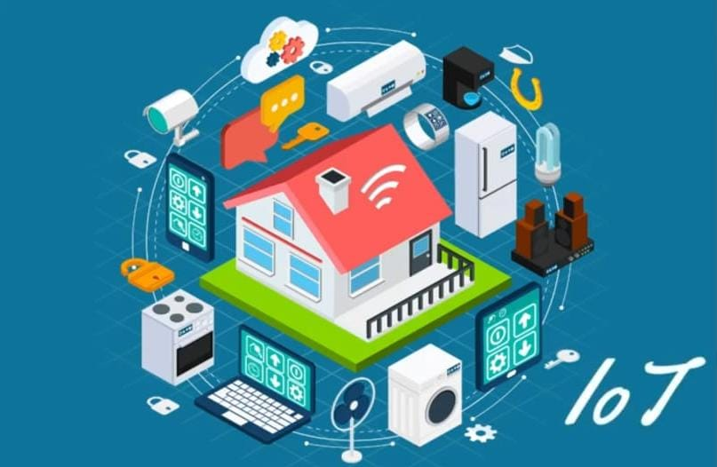
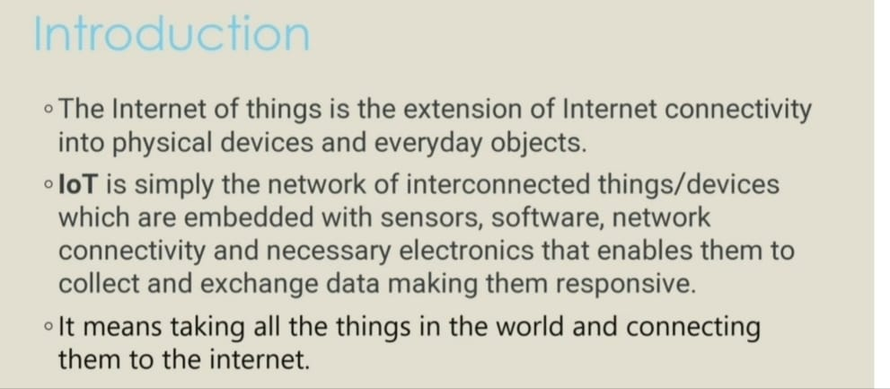

Slide 5
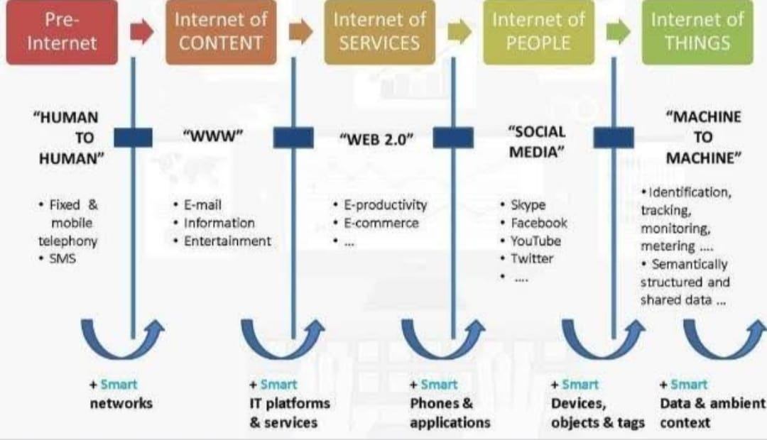

Slide 6
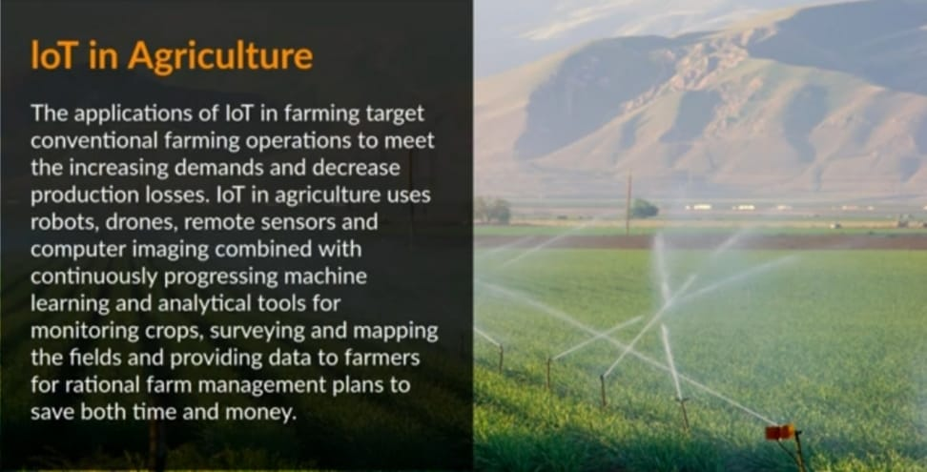

Slide 7
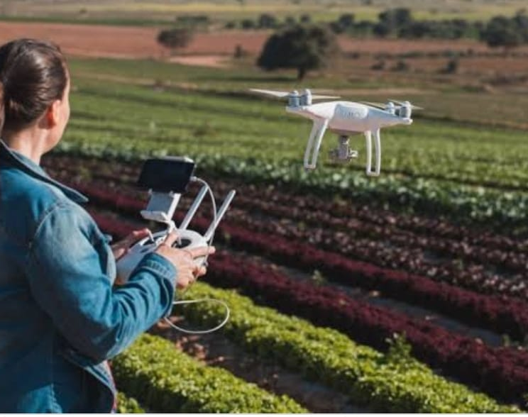
AGRICULTURE DRONES
AN AGRICULTURAL DRONE IS MOSTLY IN YEILD AND IN MOINTORING CROP GROWTH AND CROP PRODUCTION.
DRONES ENABLES OTIMUM USAGE OF ALL RESOURCES SUCH AS FERTILIZER ,WATER,SEED,AND PESTICIDES.
THE DRONE SURVEY HELPS TO BOOST CROP YIELDS AND MINIMZE TIME AND EXPENSES.

Slide 8
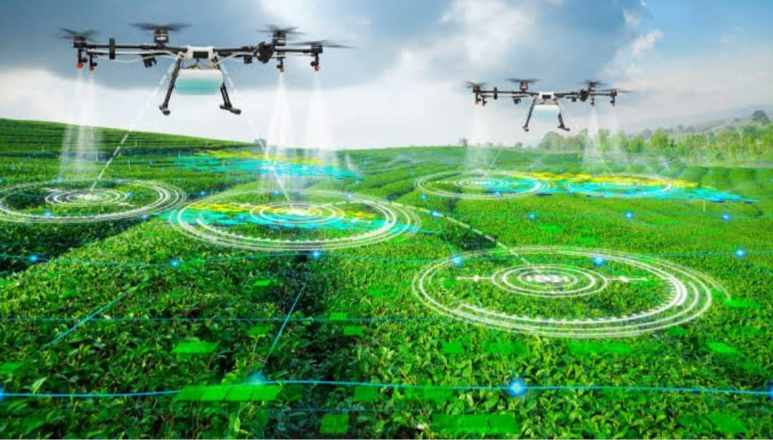
APPLICATION OF DRONE TECHNOLOGY:
DRONES WITH MACHINES VISION AND SPECIALIZED ALGORITHMS CAN BE USED TO FIND YIELD LIMITIMG PROBLEMS.
DRONES REDUCE THE USE OF HUMAN LABOUR IN SURVEYING CROPS AND CAN COVER UP TO 10 TIMES MORE GROUND IN A GIVEN AMOUNT OF TIME.
DRONES CAN HELP THE FARMERS TO SEE THE REAL HEALTH OF THE PLANTS BY ASSESSING FACTORS SUCH AS THE AMOUNT OF SUNLIGHT BEING ABSORBED BY PLANTS IN DIFFERENT AREAS OF FIELDS OR CHEMICAL COMPOSITION.

Slide 9
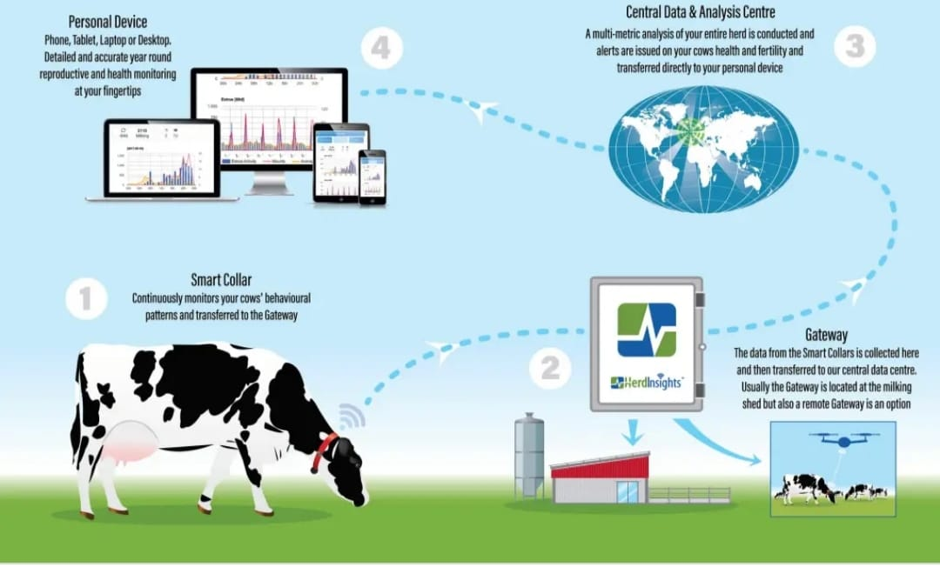
LIVESTOCK MONITORING
A LIVESTOCK MONITORING SYSTEM IS A REVOLUTIONARY SOLUTION USING SENSOR,GPS etc..
LIVESTOCK MONITORING DEVICES TO TRACK AND MONITOR THE HEALTH OF LIESTOCK.
LIVESTOCK OWNERS CAN UTILIZE WIRELESS IOT APPLICATION TO COLLECT DATA REGARDING THE LOCATION WELL-BEING AND HEALTH OF THEIR CATTLE.

Slide 10
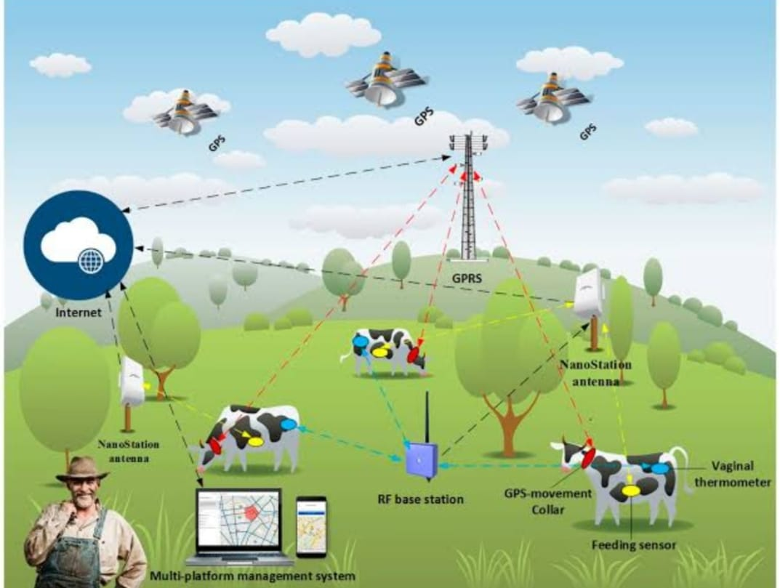
APPLICATION OF LIVESTOCK MONITORING:
THE LIVESTOCK INDUSTRY IS VERY HUGE,AND THEREFORE IT IS ESSENTIAL TO KEEP TRACK OF LIVESTOCKAND OTHER FARM ANIMALS.
THE TRACKER DEVICE CAN BE ATTACHED TO COLLARS AND CAN KEEP TRACK OF ANIMALS HEALTH, CHEWING PATTERN, LOCATION DETIALS, PASTURE MANAGEMENT, ETC….
THE USE OF SENSOR ON LIVESTOCK WHERE THE DATA IS SENT TO A CENTRALUNIT OF MONITORING, IS AN IMPLEMENTATION KNOWN AS WIRELESS SENSOR NETWORK.

Slide 11
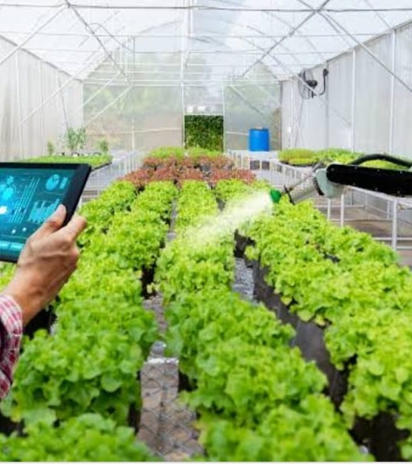
SMART GREENHOUSE
A SMART GREENHOUSE BRINGS CONVENTIONAL AGRICULTURE SYSTEM AND NEW IOT TECHNOLOGY TOGETHER FOR COMPLETE VISIBILITY AND AUTOMATION.
FOR CONTROLLING THE ENVIRONMENT IN A SMART GREENHOUSE , DIFFERENT SENSOR THAT MEASURE THE ENVIRONMENTAL PARAMETER ACCORDING TO THE PLANT REQUIREMENTARE USED.
SENSOR TO DETECT THE TEMPERATURE ,LIGHT,HUMANITY AND SOIL MOISTUREIN THE GREENHOUSE.

Slide 12
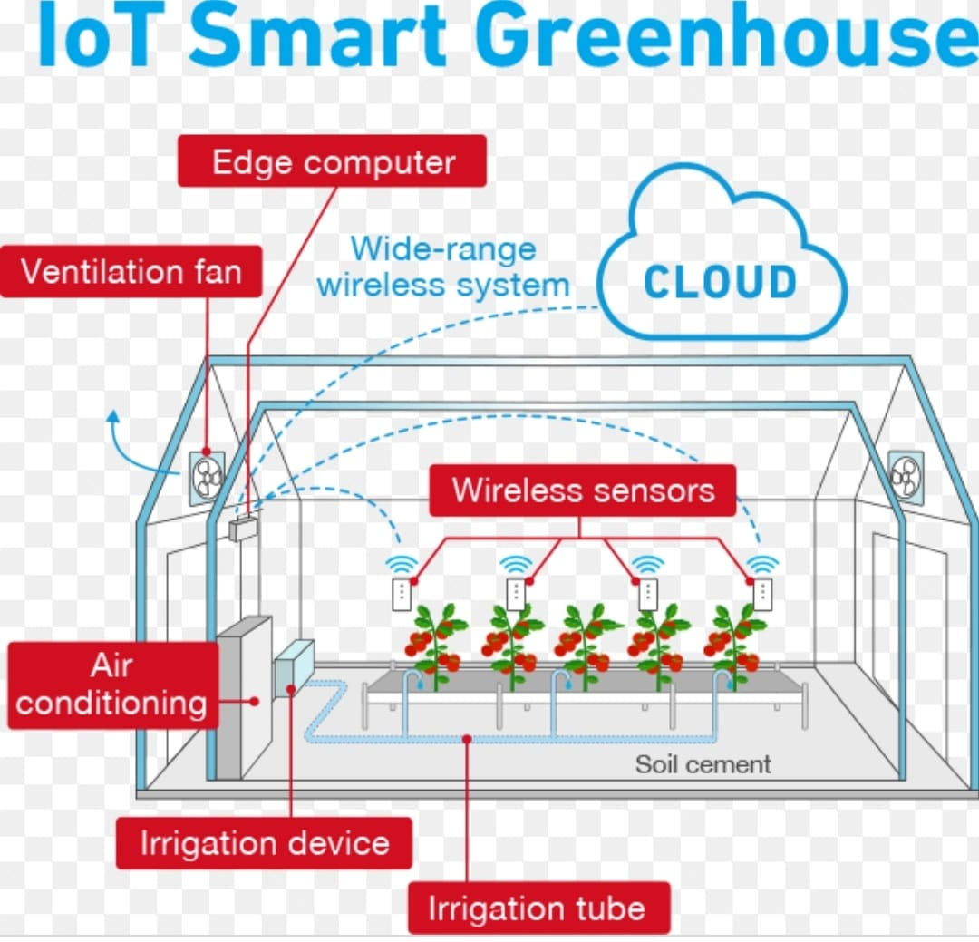
APPLICATION OF GREENHOUSE TECHNOLOGY:
GREENHOUSE IS THE TECHNICAL APPROACH IN WHICH THE FARMERSIN THE RURAL AREAS WILL BE BENEFITTED BY AUTOMATIC MONITORING AND CONTROL OF GREENHOUSE ENVIRONMENT.
GREENHOUSE CONTROL ENVIRONMENTAL PARAMETERS IN TWO WAYS ; EITHER THROUGH MANUAL INTERVENTION OR A PROPOTIONAL CONTROL MECHANISM.
A SMART GREENHOUSE THROUGH IOT EMBADED SYSTEM NOT ONLY MONITORING INTELLIGENTLY BUT ALSO CONTROLS THE CLIMATE.

Slide 13
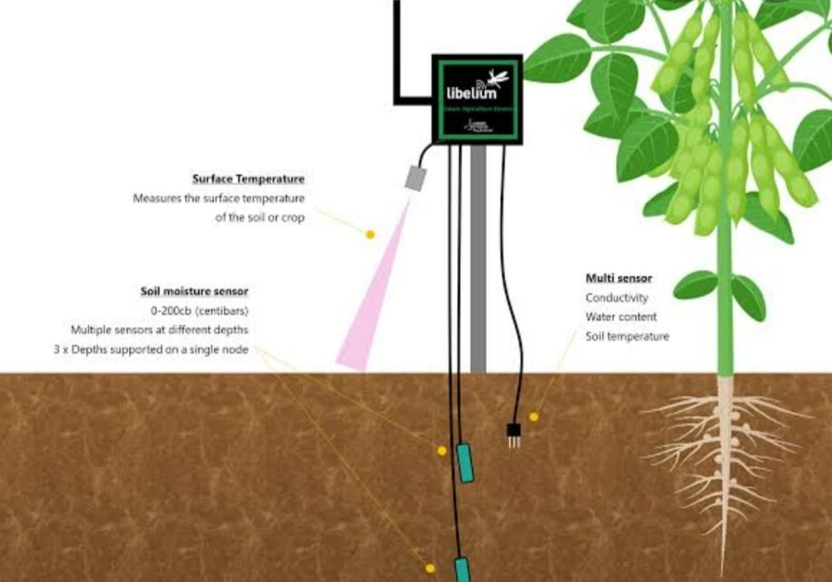
SOIL MONITORING
IOT SENSOR CAN MEASURE SOIL TEMPERATURE.VOLUMETRIC WATER CONTENT . PHOTOSYNTHETIC RADIATION ,SOIL WATERPOTENTIAL AND SOIL OXYGEN LEVELS.
SOIL MONITORING WITH IOT USES TECHNOLOGY TO EMPOWER FARMER AND PRODUCES TO MAXIMES YIELD ,REDUCES DISEASE AND OPTIMISE RESOURCES.
SURFACE TEMPERATURE
SOIL MOISTURE SENSOR
MUTLI SENSOR

Slide 14
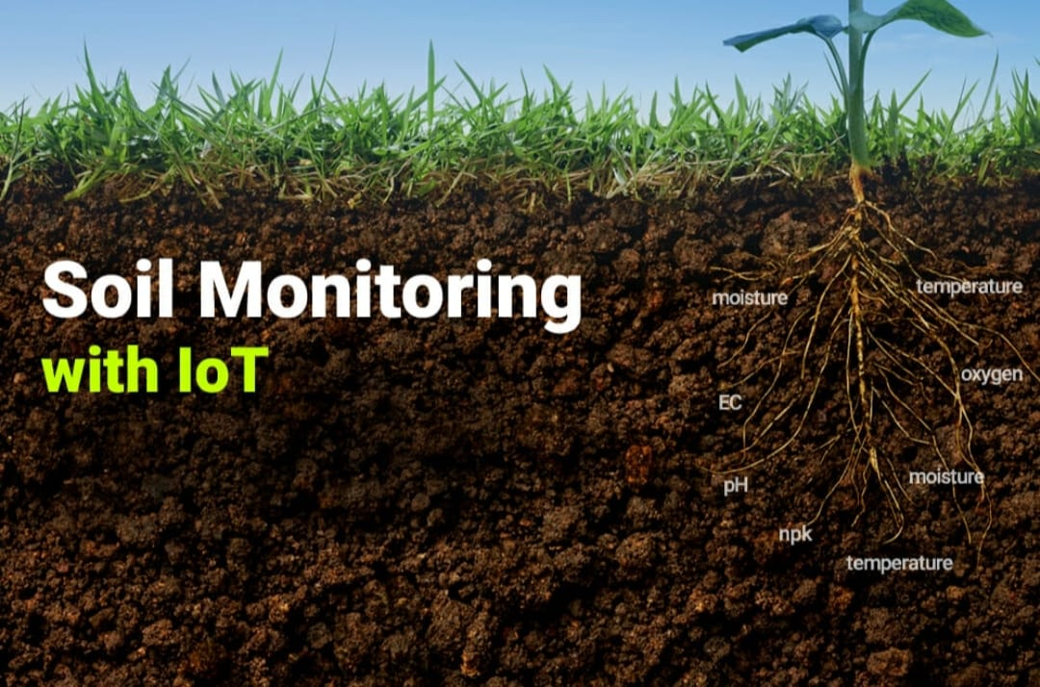
APPLICATION OF SOIL MONITORING:
IOT ALLOWS DEVICES ACROSS A FARM TO MEASURES ALL KIND OF DATA REMOTELY AND PROVIDE THIS INFORMATION TO THE FARMERS IN REAL TIME.
MONITORING THE CROP FIELD WITH THE HELP OF SENSORS AND AUTOMATING THE IRRIGATION SYSTEM.
DATA FROM THE IOT SENSORS ARE THEN TRANSMITTED BACK TO A CENTRAL POINT FOR ANALYSE , VISUALISATION AND TREND ANALYSIS.

Slide 15
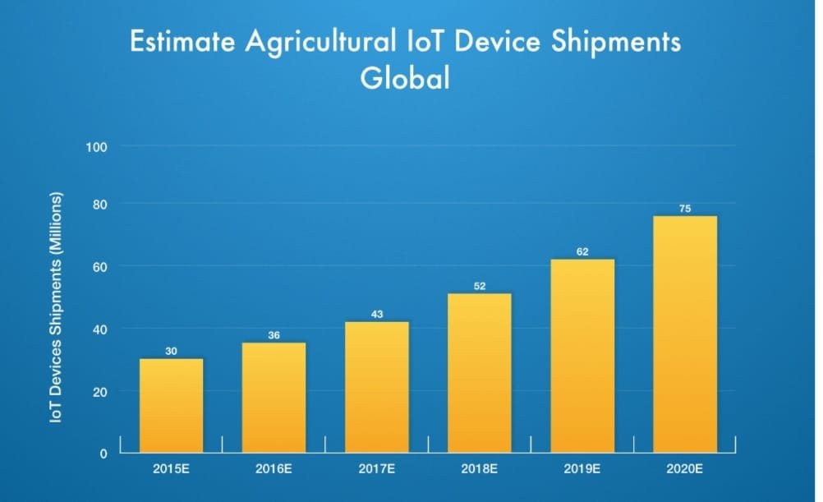
ESTIMATE AGRICULTURAL IOT DEVICES
THE INTERNET OF THINGS IS GRADUALLY RESHAPING THE WAY WE LIVED AND MANAGED BUSSINESS.
THE SMART AGRICULTURR MARKET IS EXPECTED TO REACH $18.45 BILLION IN 2022,AT A CACR OF 13.8%.
THE RANGE OF IOT DEVICES IS INCREASING BY THE PRODUCT IS SHIPING GLOBALLY.THE RATE IS INCREASING IN YEARWISE BY GRADUALLY.
THE MARKET WORTH IS ESTIMATED TO BE 7.53B IN 2018.LOOKING FUTHER AHEAD, IT WILL REACH 13B BY 2023

Slide 16
BENEFITS RISKS
IT ALLOW FARMERS TO MAXIMIZE YEILDS USING MINIMUM RESOURSES SUCH AS WATER , FETILIZER,SEEDS ETC..
SMART AGRICULTURE USE DRONES AND ROBOTS WHICH HELPS IN MANY WAY.
THESE IMPROVES DATA COLLECTION PROCESS AND HELPS IN WIRELESS MONITORING AND CONROL.
IT DELIVERS HIGH QUALITY CROP PRODUCTION.
THE SMART AGRICULTURE NEEDS AVAILABILITY OF INTERNET CONTINUOUSLY.
THE SMART FARMING BASED EQUIPMENTS REQUIRE FARMERS TO UNDERSTAND AND LEARN THE USE OF TECHNOLOGY.
MAJOR CHALLENGE IN ADOPTING SMART AGRICULTURE FRARMING AT LARGE SCALE ACROSS THE COUNTIRES.
SECURITY MEASURES ,THE SYSTEM OFFERS LITTLE POWER AND CCAN LEAD TO VARIOUS KINDS OF NETWORK ATTACKS.

Slide 17
CONCLUSION:
WE CAN CONCLUDE WITH THE FACT THAT IOT APPLICATION ARE MAKING IT POSSIBLE FOR FARMERS TO COLLECT MEANINGFUL DATA THAT IS UTILIZED TO INCREASED EFFICIENCY.
LARGE LANDLOWERS AND SMALL FARMERS MUST UNDERSTAND THE POTENTIAL OF IOT MARKET FOR AGRICULTURE BY INSTALLING SMART TECHNOLOGIES.
THE POTENTIAL OF IOT –BASED SMART FARMING AND THEY MUST IMPLEMENT IOT SOLUTION IN A PROGRESS MANNER.

Slide 18


